Slide 1
Observer Pattern

Slide 2
Intent
Define a one-to-many dependency between objects so that when one object changes state, all its dependents are notified and updated automatically.
16-<number>

Slide 3
Also Known As
Dependents, Publish-Subscribe
16-<number>

Slide 4
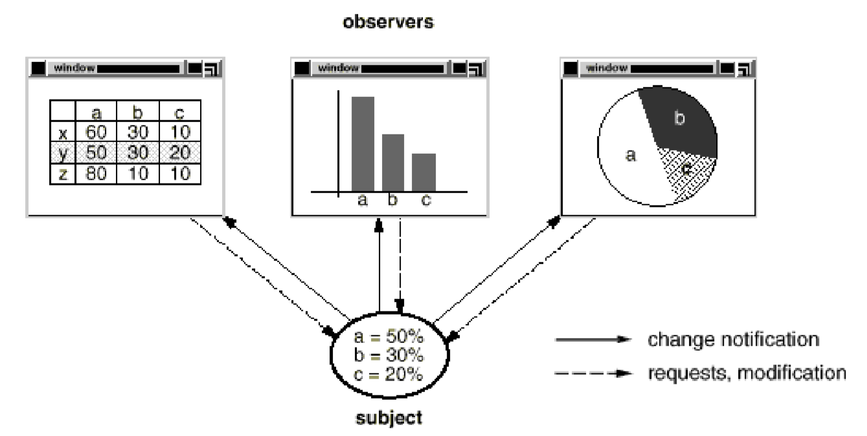
Motivation
Many graphical user interface toolkits separate the presentational aspects of the user interface from the underlying application data. Classes defining application data and presentations can be reused independently.
This behavior implies that the spreadsheet and bar chart are dependent on the data object and therefore should be notified of any change in its state.
16-<number>

Slide 5
Applicability
Use the Observer pattern when
an abstraction has two aspects, one dependent on the other. Encapsulating these aspects in separate objects lets you vary and reuse them independently.
a change to one object requires changing others, and you don't know how many objects need to be changed.
an object should be able to notify other objects without making assumptions about who these objects are. In other words, you don't want these objects tightly coupled
16-<number>

Slide 6
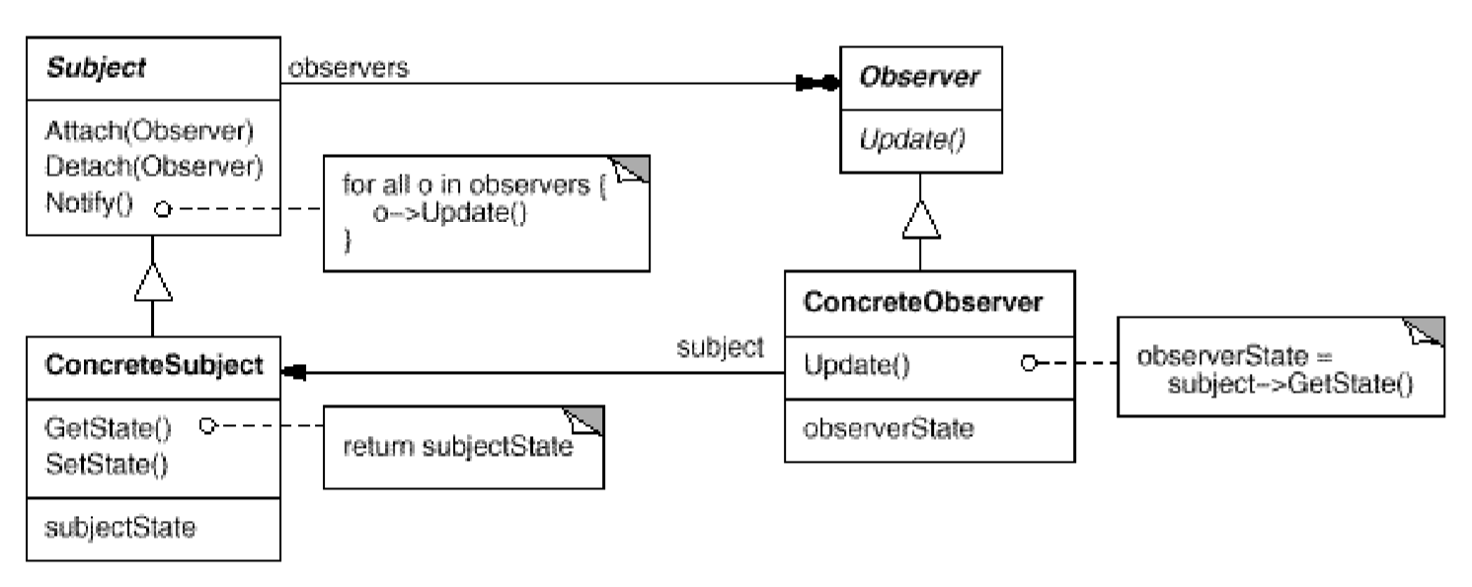
Structure
16-<number>

Slide 7
Participants
Subject:
  knows its observers. Any number of Observer objects may observe a subject.
  provides an interface for attaching and detaching Observer objects.
Observer:
  defines an updating interface for objects that should be notified of changes in a subject.
16-<number>

Slide 8
Participants
Concrete Subject:
  stores state of interest to ConcreteObserver objects.
  sends a notification to its observers when its state changes.
Concrete Observer:
  maintains a reference to a ConcreteSubject object.
  stores state that should stay consistent with the subject's.
  implements the Observer updating interface to keep its state consistent with the subject's.
16-<number>

Slide 9
Observer Pattern
Observable
state
getState()
add(o:Observer)
notify()
remove(o:Observer)
Observer
update()
observers
*
for all o in observers
o.update();
subject
Concrete Observer 1
Concrete Observer 2
Concrete
Observable
get state
update()
update()
process event
16-<number>

Slide 10
The Observer Pattern
:Concrete Observable
Observer
add(observer:Observer)
setState(s)
notify()
[ for all observers ]*: update()
16-<number>

Slide 11
Benefits and Liabilities of Observer Pattern
Abstract coupling between subject and the observer
  the subject is unaffected by the addition or removal of observers and can be reused independently of the observers.
  the observers can be added/removed at any time during system operation.
support broadcast communication.
  the observers are notified and updated automatically when the observable changes state.
Liabilities: Unexpected updates. Because observers have no knowledge of each other's presence, they can be blind to the ultimate cost of changing the subject.
16-<number>

Slide 12
A special case of the observer pattern
16-<number>

Slide 13
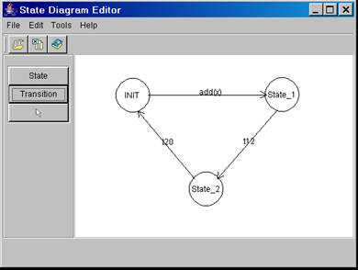
How Editor GUI Calls the Controller?
ActionListener
Edit Diagram Controller
controller.stateBtnClicked()
selectBtnClicked()
stateBtnClicked( )
transBtnClicked( )
mouseClicked(p: Point2D)
mouseDragged(p: Point2D)
mousePressed(p: Point2D)
mouseReleased(...)
actionPerformed(...)
StateButtonListener
controller
actionPerformed(...)
TransButtonListener
controller
actionPerformed(...)
state
controller.stateBtnClicked()
State
...
...
...
...
Observers and object adapters
Edit Diagram GUI
16-<number>

Slide 14
Using Java Event Handling
The common action
listener interface
ActionListener
user
action
GUI components:
buttons, scrollbars,
menu items, pop-up menu items, etc.
actionPerformed(...)
Window
System
AppEventHandler
invoke
actionPerformed
(e:ActionEvent)
actionPerformed(...)
The observables
One of the observers
The Java event handling model is an application of the
observer pattern.
16-<number>

Slide 15
Handling GUI Events
GUI events are generated when the user performs editing operations, e.g.,
  clicking File –> New to create a new document
  clicking File –> Print –> OK to print a document
There are many buttons, menu items, etc. Therefore, numerous GUI events must be handled.
How should the system handle the various GUI events?
16-<number>

Slide 16
Event Handling in Window Systems
GUI
component
(e.g., a button)
Window
System
Application
Event Handler
user
action
event object
event object
Example: Java Event Handling
submit:
JButton
eventHandler:
ActionListener
:WindowSystem
e:ActionEvent
<<user clicks>>
create(submit, id, cmdString)
fireAction
Performed
(e)
actionPerformed(e)
This sequence diagram illustrates how the window system works. It is not a design of an application system.
process
submit
event
16-<number>

